Slide 1
Playing scientific game to help the protection of the Mediterranean Sea
SCIENTIFIC GAME
https://medregion.eu/publications/

Slide 2
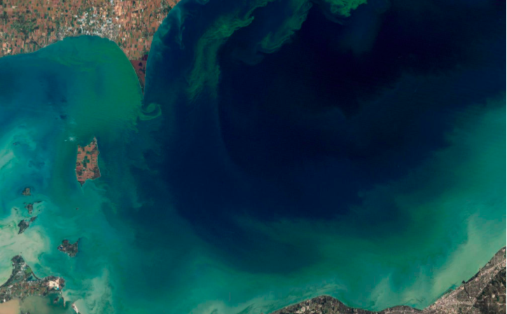
MEDREGION PROJECT GOAL Support the competent authorities of the MSs by addressing their cooperation needs to implement the MARINE SRATEGY FRAMEWORK DIRECTIVE
For more information about the project
CLICK HERE
For more information about the Marine Strategy Framework Directive CLICK HERE
https://medregion.eu/about/background/

Slide 3
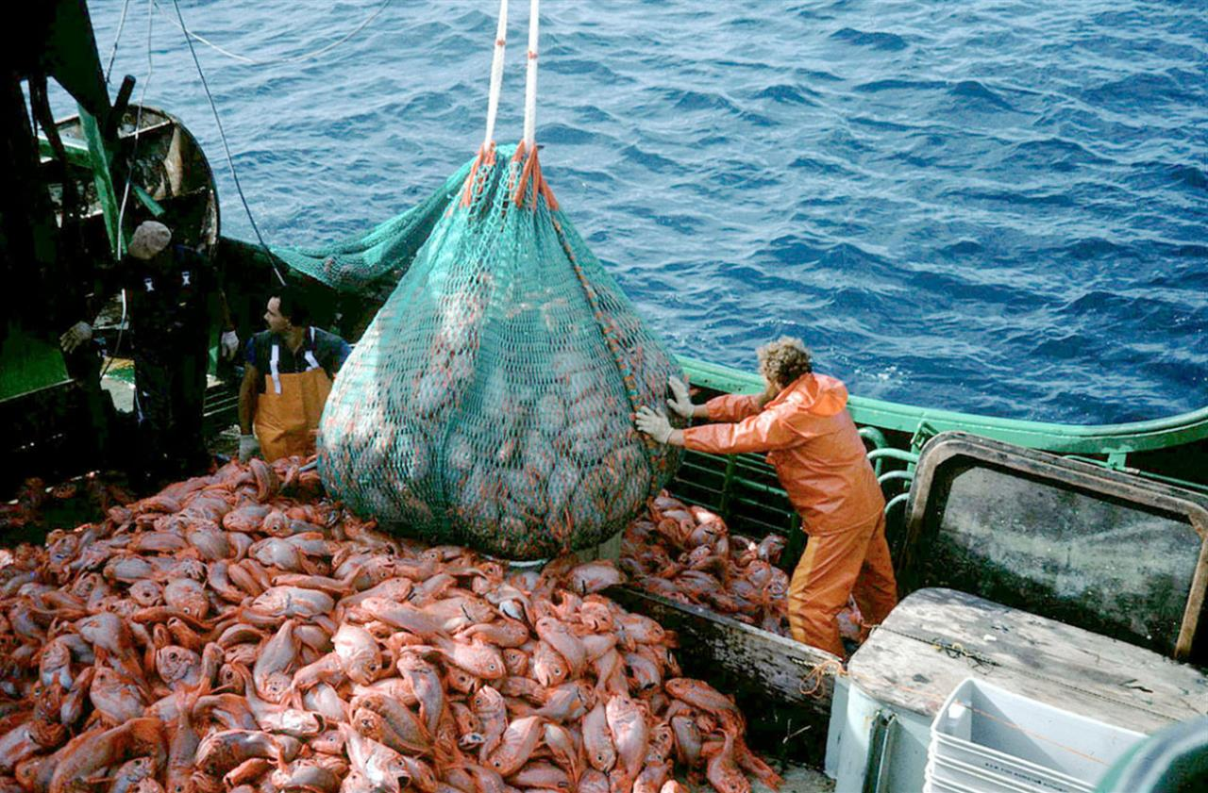
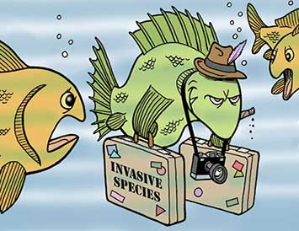
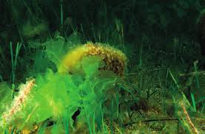
MARINE PRESSURES
Among the most relevant ANTHROPOGENIC pressures there are:
Overfishing
Alien species
Marine litter
Eutrophication
EMERGENCY
Underwater noise

Slide 4
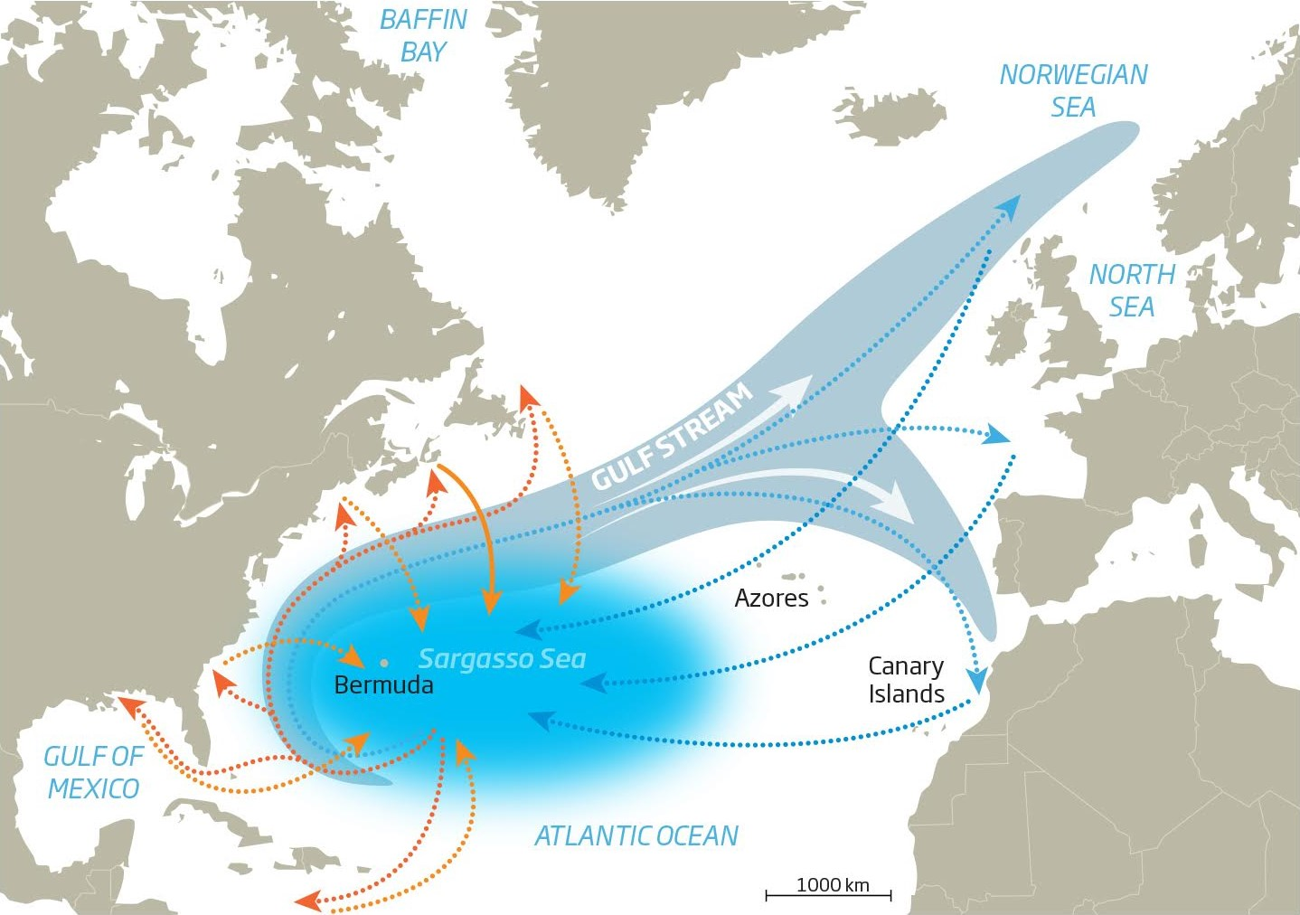
… for example the marine litter …
The world produces 300 million tonnes of plastic a year. There are 5 trillion pieces of plastic in the ocean, and 90% of seabirds have swallowed plastic.
The first report of plastics litter in the oceans dates back to 1970.
Actually, the Great Pacific Garbage Patch, also known as the Pacific trash vortex, spans waters from the West Coast of North America to Japan (from 700.000 km² to more than 10 millions km² including more than 3 millions tonnes of waste).

Slide 6
SCHOOLS or

Slide 7
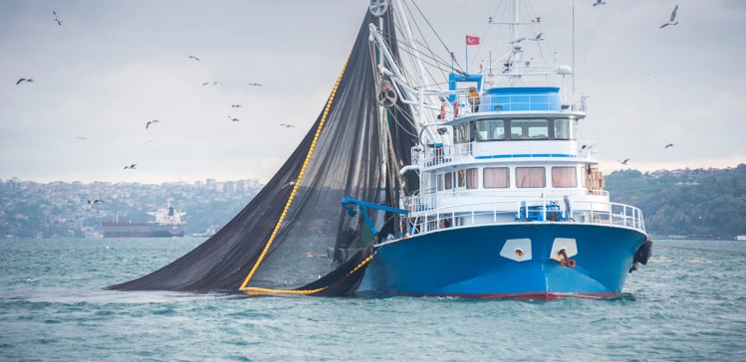
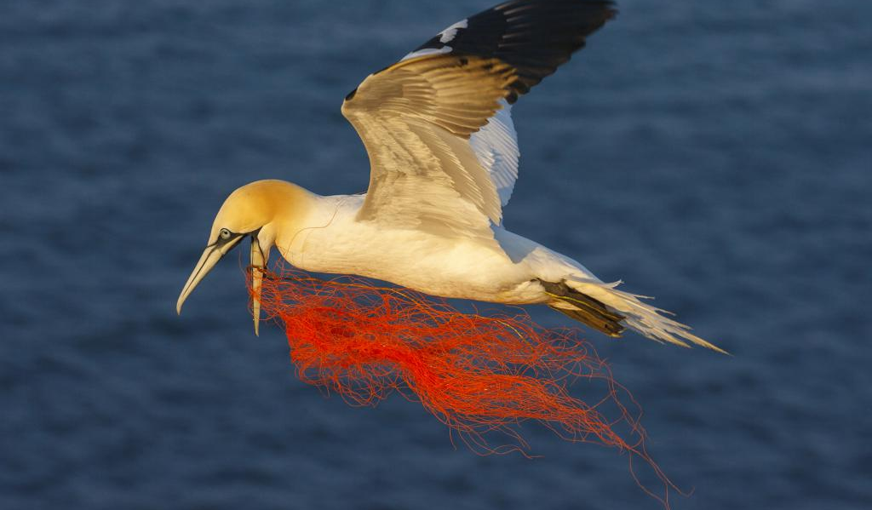
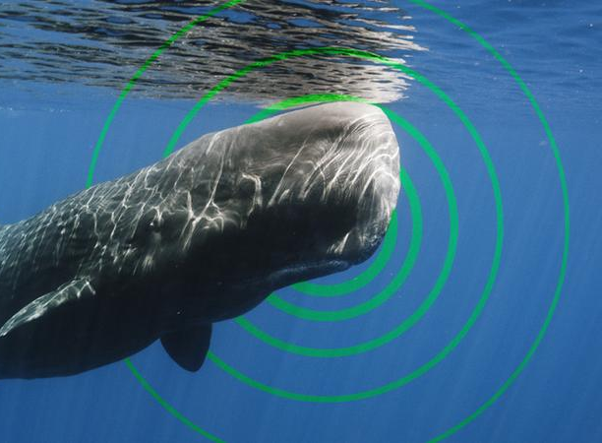
DESCRIPTOR 1
WE PROPOSE A
SCIENTIFIC GAME
APPLIED TO SEA ISSUES
BIODIVERSITY
DESCRIPTOR 10
Marine Strategy Framework Directive
MARINE LITTER
DESCRIPTOR 11
The Game has been planned to arouse interest of students and citizens on the protection of the sea in European area
UNDER WATER
NOISE

Slide 8
MEDREGION PILOT GAME
A new online game is planning in MEDREGION PROJECT
Here we are presenting the game
Tour operators
Divers
Monitoring technicians
Specialists in aquaculture
Coast Guard
Fishermen
Environmental organizations
YOU ARE A SCHOOL
OR
YOU ARE HERE …

Slide 9
Technical information
GAME TECHNICAL INFORMATION
The player has to cover different objectives in the game.
The Scientific games are about the MSFD and aim at improving the knowledge on marine issues and promoting the protection of the sea for young people, such as students, and stakeholders.
The mini-games have a fixed structure presented in the next page.

Slide 10
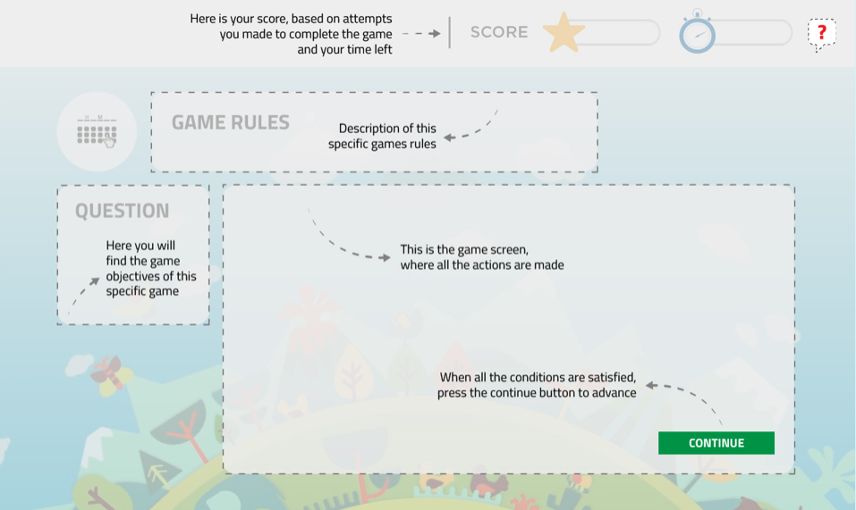
Game structure

Slide 11
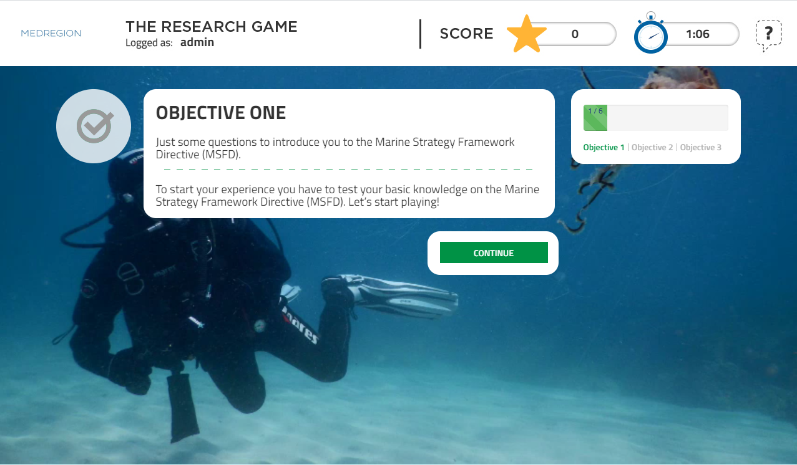
Game objective -1-
Just an example

Slide 12
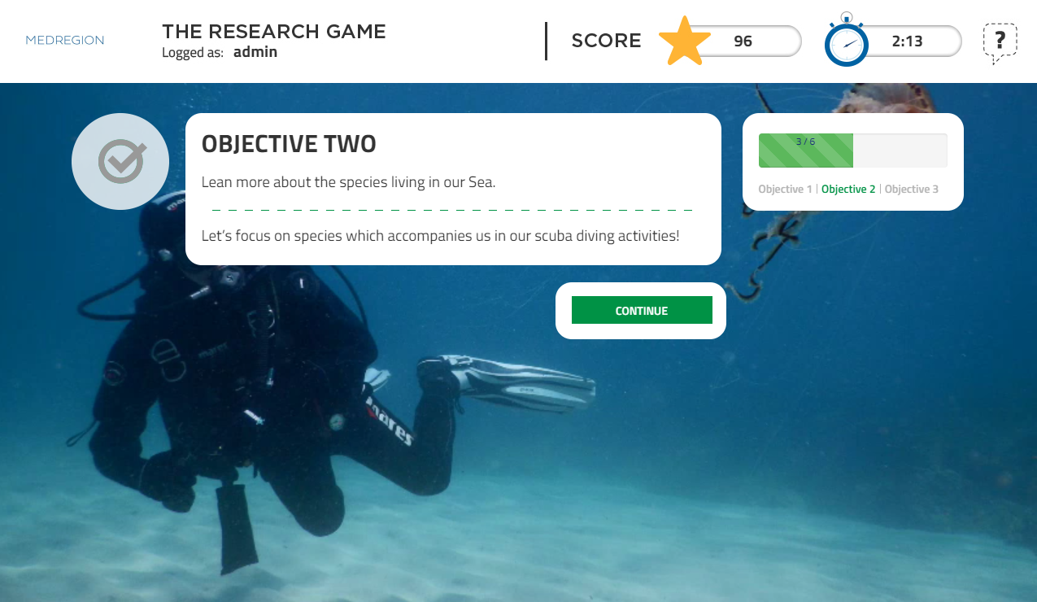
Game objective -2-
Just an example

Slide 13
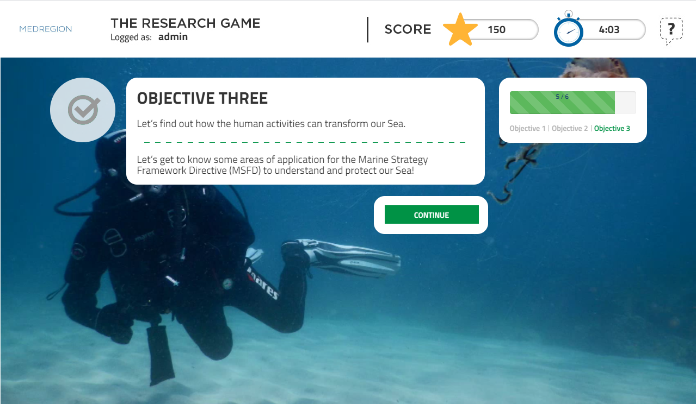
Game objective -3-
Just an example

Slide 14
Just an example …

Slide 15
MANY THANKS FOR YOUR PARTICIPATION
Edited by:
Alberto Basset
Mario Ciotti
Franca Sangiorgio
©lazininamarina

